Slide 1

Course Teachers: Md. Rezaur Raihan Assistant Professor, Dept. of EEE & Md Arafat Hossain Assistant Professor, Dept. of EEE
Course No. : EEE 1108
Course Title : Basic Electrical Engineering Sessional
Credits: 1.5
Department of Electrical and Electronic Engineering
Khulna University of Engineering & Technology

Slide 2
Syllabus:
Laboratory Works: Experiments based on Basic Electrical Engineering
Direct Current: Voltage and current, resistance and power, Laws of electrical circuits and methods of network analysis, Principles of dc measuring apparatus.
Alternating Current: Instantaneous and r.m.s. current, voltage and power, Average power for various combinations of R, L, and C circuits, Phasor representation of sinusoidal quantities, Introduction to three phase circuits.
Magnetism: Laws of magnetic fields and methods of solving simple magnetic circuits.
Electrical Machines: DC generators and alternators; Introduction to transformer and its operating principles; Operating principles of DC and stepper motors.

Slide 3
List of Experiments:
No. | Name of the Experiments
01 | Familiarization with electrical elements and measuring instruments
02 | Study and verification of ohm’s law
03 | Study and verification of KVL and KCL
04 | Verification of superposition theorem
05 | Measurement of power in series and parallel circuit
06 | Determination of circuit parameters of an R-L series circuit

Slide 4
List of Experiments :(contd.)
No. | Name of the Experiments
07 | Measurement of line voltage and phase voltage of a 3-φ system
08 | Determination of open circuit characteristics curve of a dc generator
09 | Speed control of a dc shunt motor by varying armature voltage keeping the field current constant (armature control method)
10 | Open circuit test and short circuit test of a 1-φ transformer
Notes:
a branch of "Artificial Intelligence".

Slide 5
Assessment criteria:
Attendance/Class Participation 10%
Lab Reports and Class Performance (Includes Lab Test, Lab viva) 50%
Quizzes/Viva Voce 20%
Central Viva 20%
Total 100%

Slide 6
Exp. No. : 01
Name of the Experiment: Familiarization with electric meters and verification of ohm’s law

Slide 7
Electric Meters:
Ammeter
Voltmeter
AVO meter, Commercially called Multimeter
Wattmeter

Slide 8
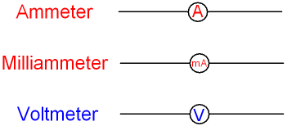
Ammeter
Measures the amount of current flow through the branch of a circuit.
Types:
1. DC Ammeter
2. AC Ammeter
Circuit symbols

Slide 9
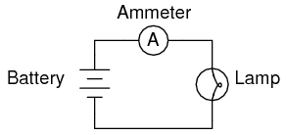
Typical connection of Ammeter:
Ammeter Should always be connected in Series with Load

Slide 10
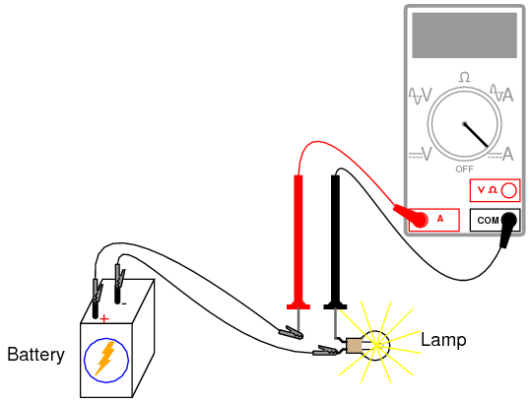
Connection Diagram of Ammeter:

Slide 11
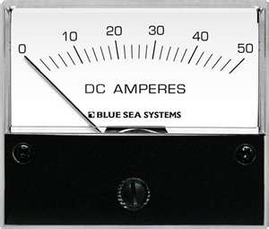
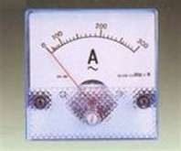
Pictorial View of DC & AC Ammeter
DC Ammeter
AC Ammeter

Slide 12
Voltmeter
Used to measure Electrical potential difference between two points in an electric circuit
Types:
1. DC Voltmeter
2. AC Voltmeter

Slide 13
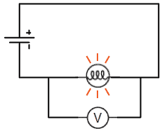
Connection Diagram of Voltmeter:
Battery
Load
Voltmeter
Voltmeter must be connected in Parallel with Load !!

Slide 14
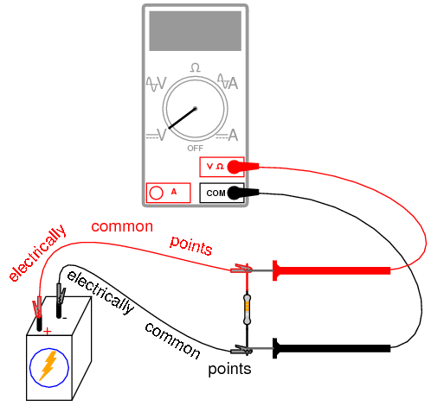
Connection Diagram of Voltmeter:

Slide 15
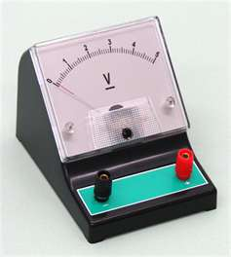
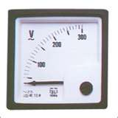
Pictorial View of DC & AC Voltmeter
AC Voltmeter
DC Voltmeter

Slide 16
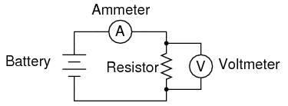
Summary:
Connection of ammeter and Voltmeter in a circuit

Slide 17
Question?
What happens when the ammeter is connected in parallel and voltmeter connected in series
V

Slide 18
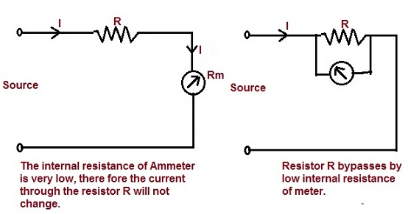

Slide 19
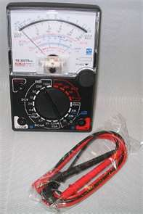
Multimeter/AVO meter:

Slide 20
Wattmeter
Measures the Electric power (active/real power) in watts
Types:
1. Analog Wattmeter
2. Digital Wattmeter

Slide 21
Schematic Diagram of Wattmeter:
Current coil (cc)
Current
Supply
Pressure coil (pc)
Measured Power, P=VI

Slide 22
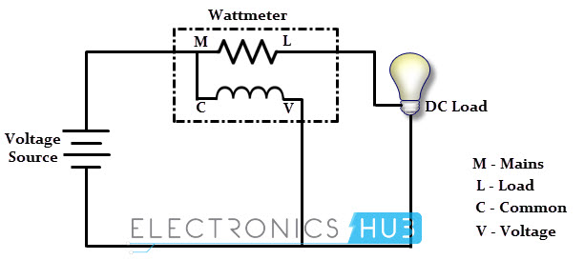
Connection Diagram of Wattmeter:

Slide 23
Pictorial View of Wattmeter:

Slide 24
Report Writing:
Objectives
Introduction
Apparatus Required
Experimental Setup or Circuit Diagram
Experimental Data
Calculation
Graphs /Vector Diagrams (if any)
Results and Discussion
Conclusion
Question & Answer
References

Slide 25
Objectives:
Purpose of Experiment e.g.To be familiar with the working principle of various electric meters.
Should be mentioned in points

Slide 26
Introduction:
Introductory Description. e.g. Why and where ammeter, voltmeter & wattmeter are used.
Written in one Para

Slide 27
Description of the work:
Working principle and additional figures
Theoretical Background of the experiment

Slide 28
Apparatus Required:
Should be mentioned in numbers
Name of Equipments with rating
Quantity

Slide 29
Experimental Setup:
The diagram of the work
Specify the Equipments
Direction of current flow
Polarity (if any)

Slide 30
Experimental Data:
Should be written in table
Draw Table using Pencil & Ruler.

Slide 31
Calculation:
Elaborate Calculation of the whole work
Mark the outcomes of the calculation with square box which will be discussed in the discussion and conclusion.

Slide 32
Graph/Vector Diagram:
Proper Scaling of axis
Encircle the plotted data points
Labeling [Units should be included]
Figure No. along with figure name should be mentioned

Slide 33
Result & Discussion:
Discuss your results
Comparison between measured and ideal value.
Is there any deviation in your result from ideal value & why?
Mention numerical values of different quantities(if any).
Discuss your graphs along with the possible deviation in it (if any)
Use proper scaling for current and voltage in the vector diagram.

Slide 34
Conclusion:
What have you learnt from this experiment?
What is the necessity of this experiment?
What is the way to abase the error [if any]

Slide 35
Question and Answer:
Questions must be written in your report.
Relevant answer should be written.

Slide 36
Reference:
Sources- you have used to write the report
For more references – write in numbers
e.g. [1] writer name, “source name”.
[2]……………..

Slide 37
References of Today’s Experiment:
[1] B.L. Theraja, “A Textbook of Electrical Technology, Volume I”.
[2] Robert L. Boylestad, “Introductory Circuit Analysis”.

Slide 38
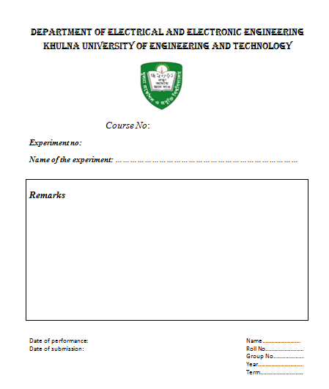
Top page of Sessional Report:

